Slide 1
Prediction of housing price in Melbourne
ALY6140 Analytics System Technology
Capstone Project Presentation
Presented by: Shreyansh Bhalodiya
Pui Man SIU
Megha Bhagat
Date: 29th March, 2023

Slide 2
Agenda
01
Background Information
02
Rationale & Problem Statement
03
Research Questions
04
Exploratory Data Analysis
05
Predictive Models
06
Conclusion

Slide 3
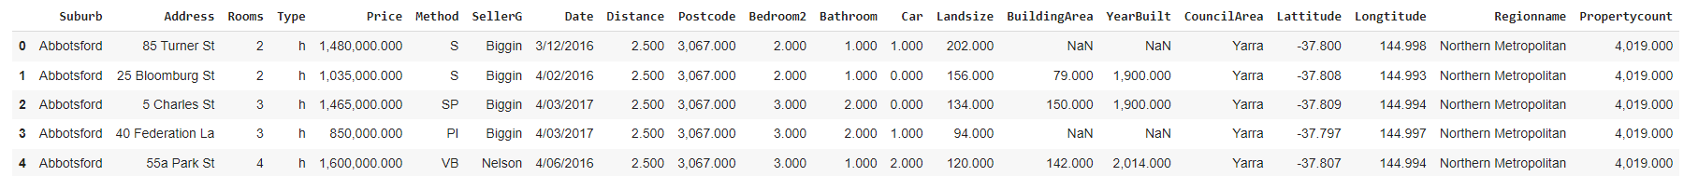
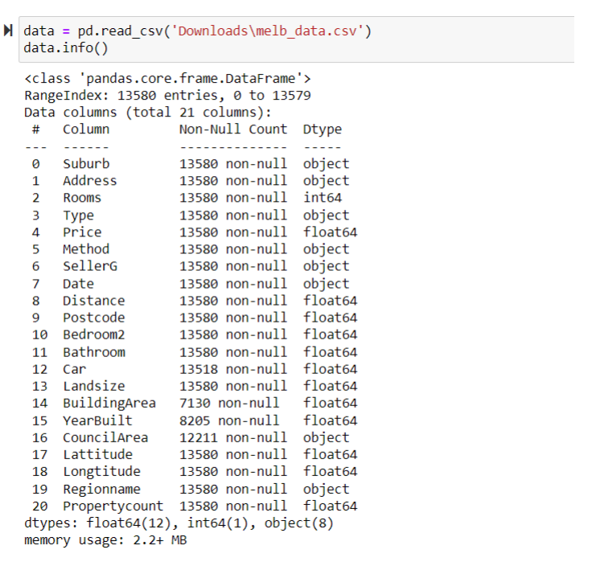
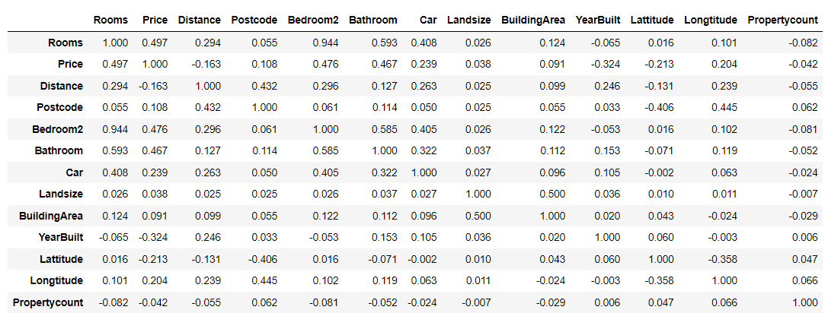
Background Information
Melbourne house pricing dataset consists of 13580 listings and has 21 different dimensions

Slide 4
Rationale and Problem Statement
Rationale
Real world data set and problem
The dataset has huge variety of data - numerical, categorical, geographical
The data requires fair amount of data pre-processing before it can be consumed for modelling
Problem statement
To accurately predict the house price in Melbourne based on various factors, such as location of the house, land size, number of rooms
Three different regression models used for house price prediction -
Linear Regression
K-Nearest Neighbor
Random Forest Regression

Slide 5
Research questions
Through the Melbourne housing price data, we would like to leverage analysis and machine learning models to answer below questions
What is the age distribution of properties in Melbourne?
Which area has the highest growth in property price?
What are the key drivers influencing the housing price in Melbourne?
Is there a significant difference in house price between different regions of Melbourne?
What is the predicted price of a house given the different features in the next few months?

Slide 6
Exploratory Data Analysis

Slide 7
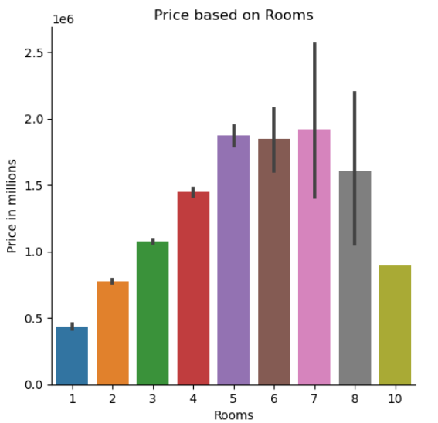
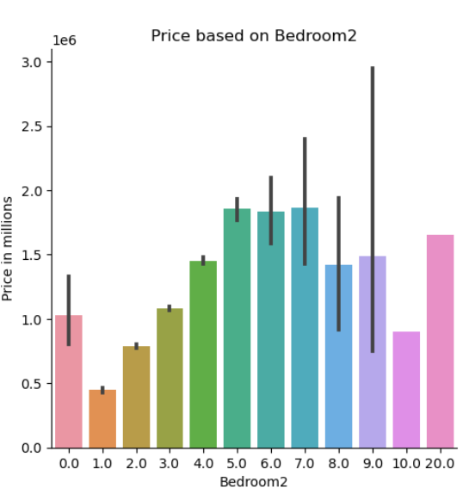
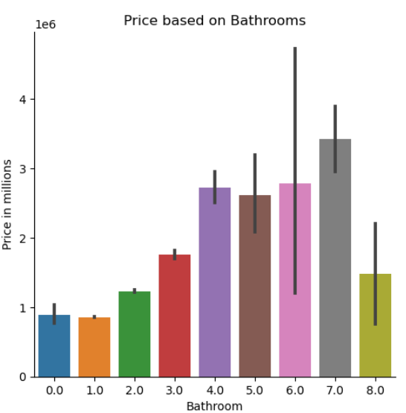
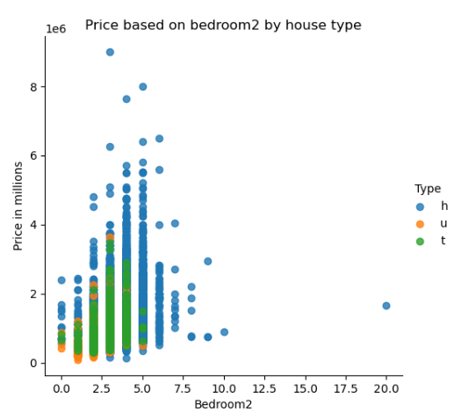
Price based on various House Attributes

Slide 8
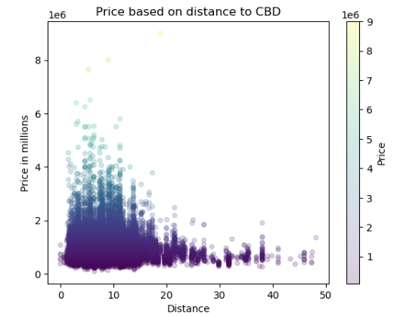
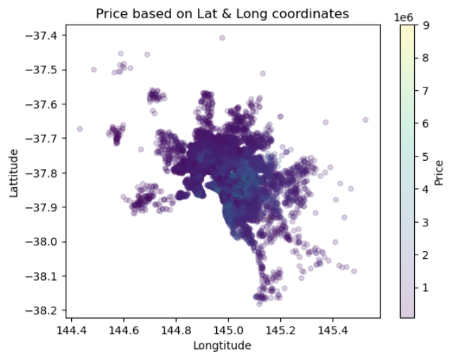
Price based on the House Location

Slide 9
What we did in Exploratory Data Analysis?
Collect Data
Data Exploration
Data cleansing & transformation
Model Building
Communicate Results
With the help of summary statistics and visualizations, we perform initial investigation and manipulation of data to achieve the below:
Handle missing values
Detect and handle outliers
Transform variables to prepare for machine learning models
Initial discovery of pattern in data to answer business questions

Slide 10
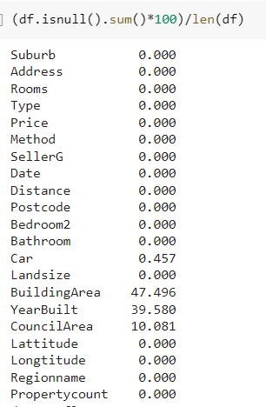
Handle missing values by imputation
% of null values for each field
BuildingArea
Compute the area to land size ratio
= Building Area / Landsize
Calculate average of area to land size ratio
Impute average value to records with null values
Multiply the AreaToLandRatio * Landsize to get final Building Area
Data Imputation
YearBuilt
KNN imputer to impute missing values
imputed with mean value of YearBuilt of k nearest neighbors of similar latitude and longitude

Slide 11
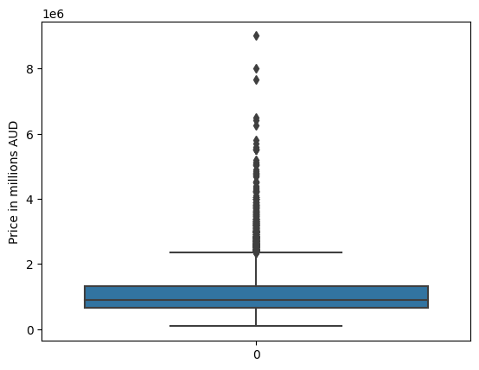
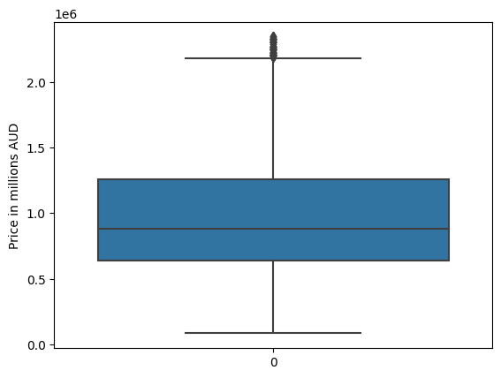
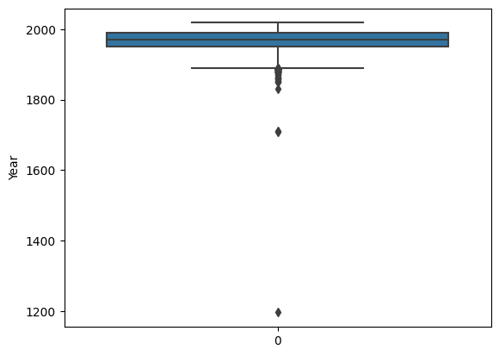
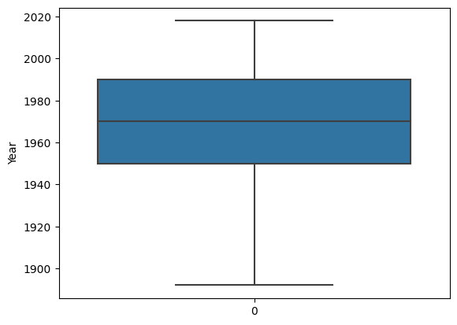
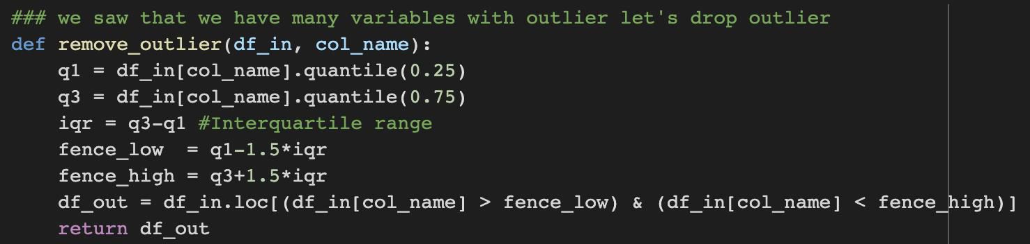
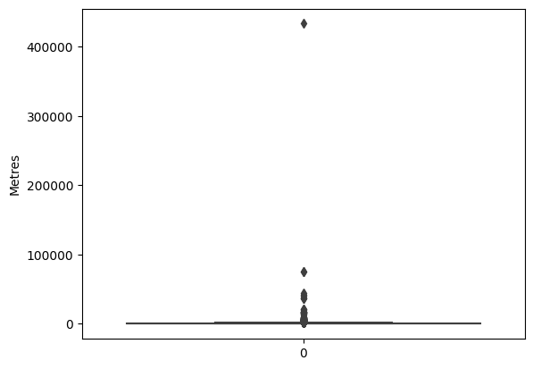
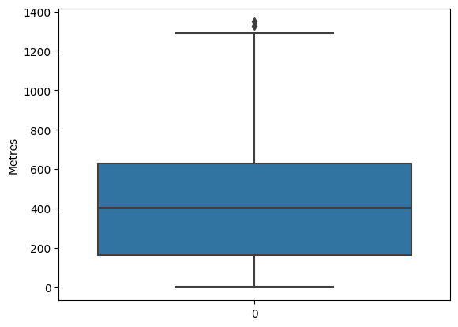
Outlier analysis and handling
PRESENCE OF OUTLIERS
CLEANSED DATA
Price
Price
REMOVE OUTLIERS:
a function is created to remove outliers
remove observations outside the range of Q1 - 1.5 IQR and Q3 + 1.5 IQR
Year built
Year built
Landsize
Landsize

Slide 12
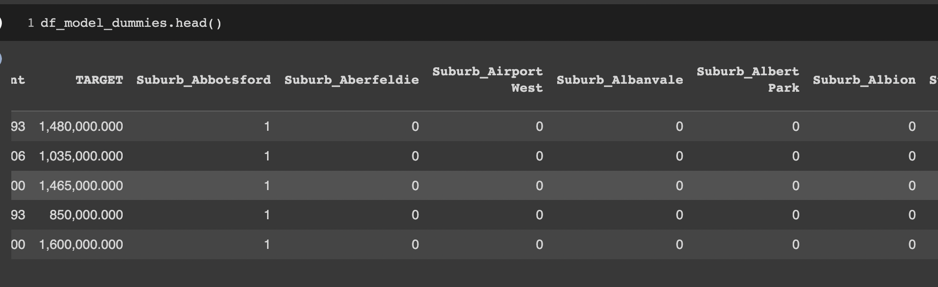
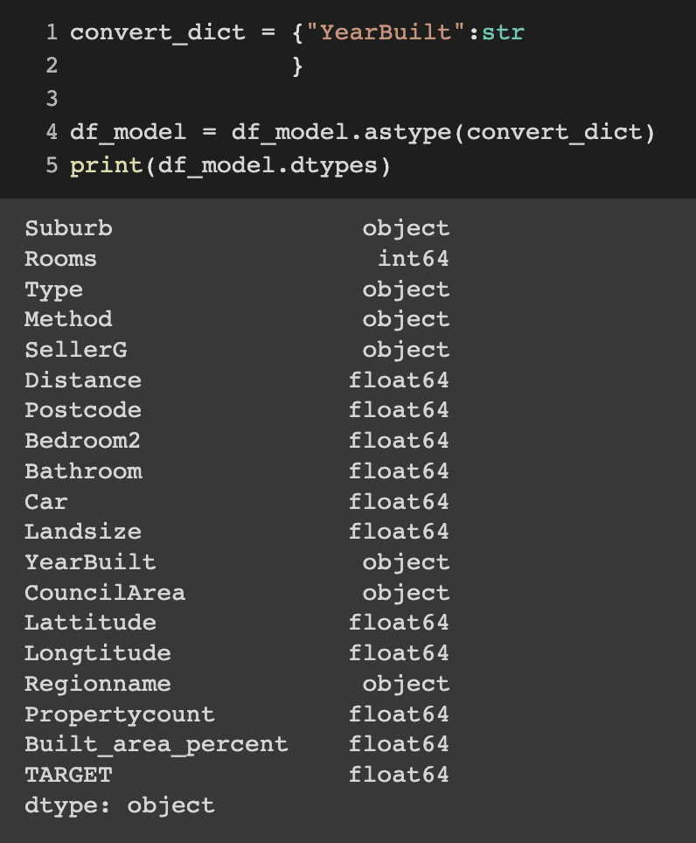
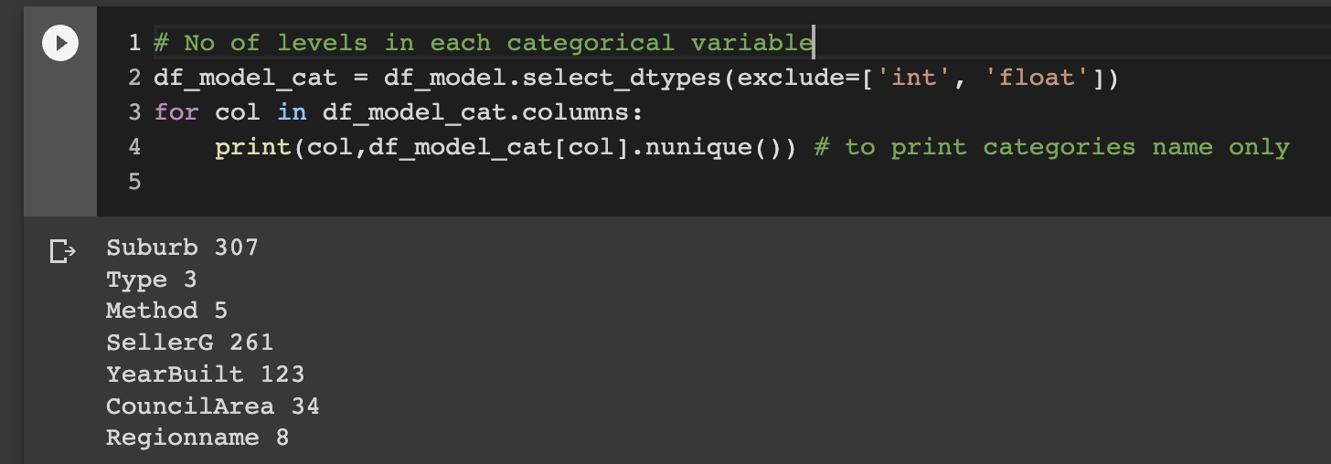
Data transformation for building machine learning models
1. Drop unnecessary variables
e.g. Date, Address
3. Generate dummy variables
there are 741 dummy variables after transformation 7 categorical variables
The number of categories under each categorical variable is as below:
2. Data type conversion
convert YearBuilt from integer to string

Slide 13
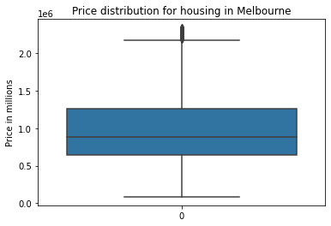
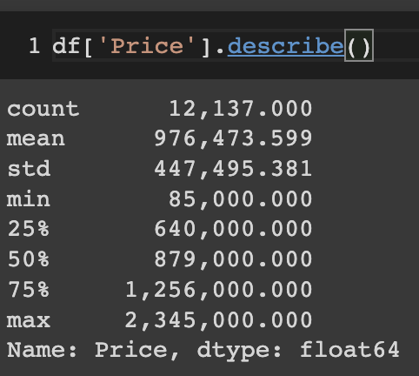
Our target variable – Housing Price
Housing Price in Melbourne ranges from $0.09m to $2.3m in 2016 to 2017
Mean price at $0.98m and medium price at $0.88m

Slide 14
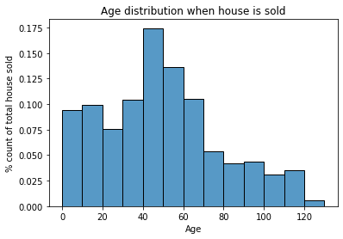
What is the age distribution of properties in Melbourne?
Age of house can range from 0 to ~120 years old in Melbourne
Distribution is right skewed
Most house is between 40-50 years old with 17.5% of sample
More than half of the houses are below 50 years old

Slide 15
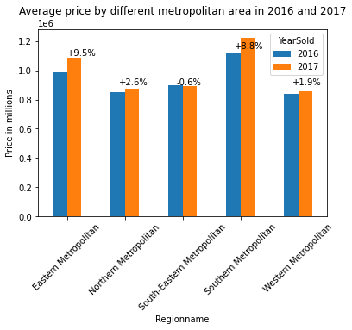
Which metropolitan area has the highest growth rate in property price?
Eastern Metropolitan has the highest growth rate of 9.5%, followed by Southern Metropolitan area at 8.8%
Highest price remained in above two regions in 2016 and 2017
Minimal growth rate observed in Northern and Western area
Drop in property price in South Eastern Metropolitan area by 0.6%

Slide 16
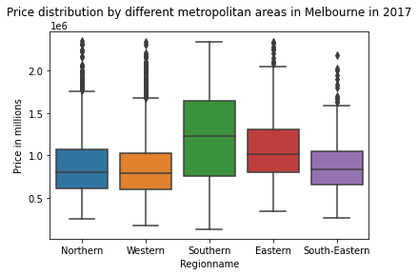
Does housing price differ between different metropolitan areas in Melbourne in 2017?
Southern region is the highest in median price while Eastern region follows by
Southern Metropolitan region has the largest range vs other regions, indicating the largest dispersion of price, also it has the longest box meaning middle 50% of observations scatter farther apart than other regions in price
Northern, Western and South-Eastern share some similarities in the price distribution regarding the median price, length of box -represents the middle 50% of sample and length of whiskers - represents the top and bottom 50% of sample

Slide 17
Predictive Models

Slide 18
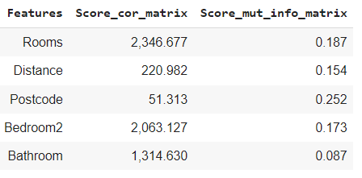
Feature Selection
Correlation Matrix
Most relevant features
Mutual Information Matrix
Maximum relevant features
F_regression function
Mutual Info regression function

Slide 19
What are the key drivers influencing the housing price in Melbourne?
Rooms
Distance
Postcode
Bedroom2
Bathroom
Car
Landsize
Method - 'MethodSP'
Lattitude/Longtitude
Built_area_percent
Suburb - 'Suburb_Albert Park', 'Suburb_Ashburton', 'Suburb_Balwyn', 'Suburb_Balwyn North', 'Suburb_Brighton', 'Suburb_Brighton East', 'Suburb_Camberwell', 'Suburb_Glen Iris', 'Suburb_Glenroy', 'Suburb_Hampton', 'Suburb_Kew', 'Suburb_Kew East', 'Suburb_Malvern East', 'Suburb_Reservoir', 'Suburb_Sunshine West', 'Suburb_Surrey Hills'
Type - 'Type_h', 'Type_u'
SellerG - 'SellerG_Barry', 'SellerG_Buxton', 'SellerG_Fletchers', 'SellerG_Jellis', 'SellerG_Marshall', 'SellerG_Stockdale', 'SellerG_YPA'
YearBuilt - 'YearBuilt_1900', 'YearBuilt_1910', 'YearBuilt_1920', 'YearBuilt_1925', 'YearBuilt_1930', 'YearBuilt_1960', 'YearBuilt_1970'
Council - 'CouncilArea_Bayside', 'CouncilArea_Boroondara', 'CouncilArea_Brimbank', 'CouncilArea_Hume', 'CouncilArea_Manningham', 'CouncilArea_Maribyrnong', 'CouncilArea_Melton', 'CouncilArea_Moreland', 'CouncilArea_Whittlesea', 'CouncilArea_Wyndham'
Regionname - 'Regionname_Northern Metropolitan', 'Regionname_Southern Metropolitan', 'Regionname_Western Metropolitan'

Slide 20

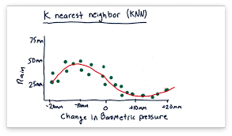
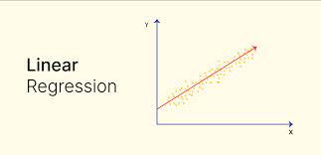
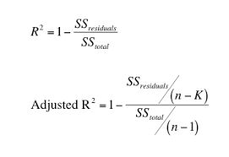
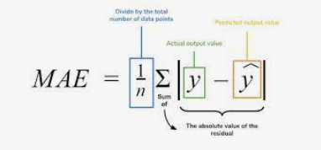
Modelling
Evaluation Matrix | Linear Regression | K-Nearest Neighbour | Random Forest Regressor
R-SQUARE | 0.834 | 0.870 | 0.907
ADJUSTED R-SQUARE | 0.833 | 0.817 | 0.906
MAE | 186110.96 | 189667.65 | 131941.38

Slide 21
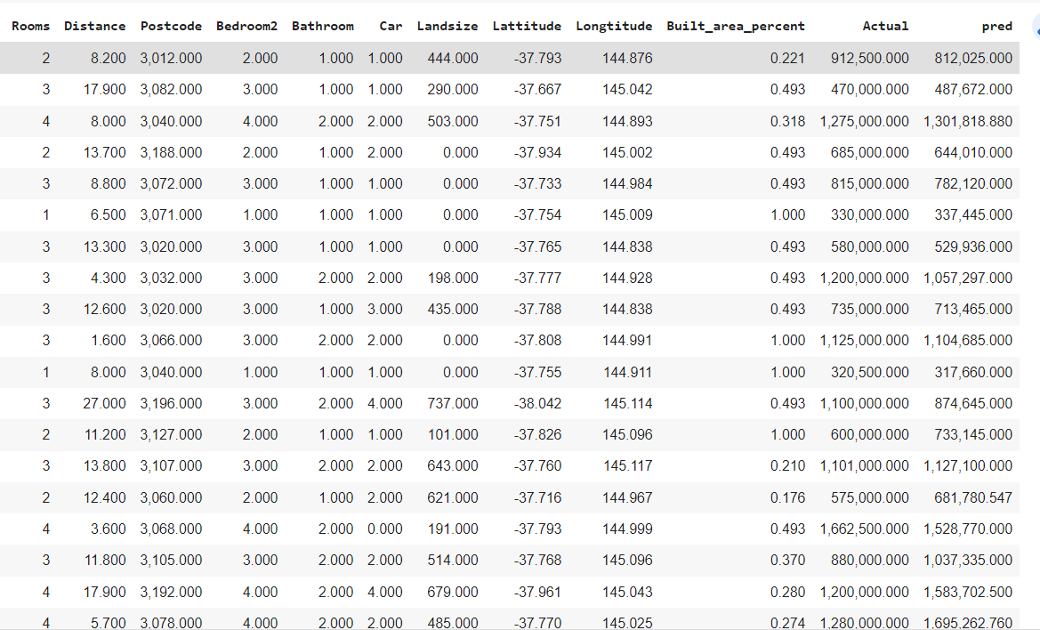
What is the predicted price of a house given the different
features ?

Slide 22
Conclusion
From EDA:
Average housing price in Melbourne is $1m
17.5% of housing falls into age of 40-50 years old
Eastern and Southern Metropolitan area have the highest growth rate in price
From predictive models:
Random Forest Regressor is the best out of the three models with lowest MAE and highest R²
Also adjusted R-square is closer to R-square which is a very good sign, and we can conclude that features selected are fair enough to give best results and there is no over fitting in model.
Also, we can conclude that the predicted value for house price may differ + - 131941.38

Slide 23
Thank you

